Slide 1
Whole Family Therapeutic Intervention

Slide 2
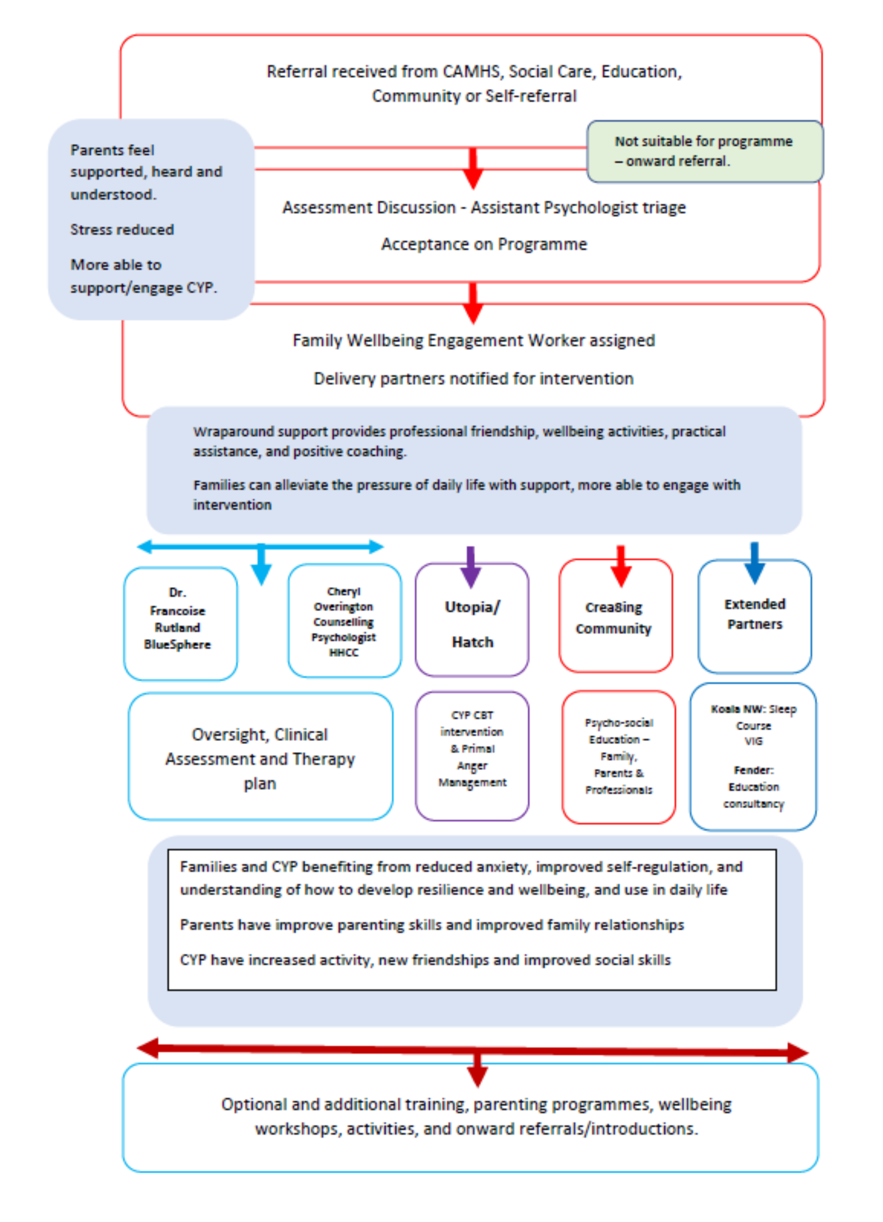
Accessing the programme
Notes:
Discuss Theory of Change

Slide 3
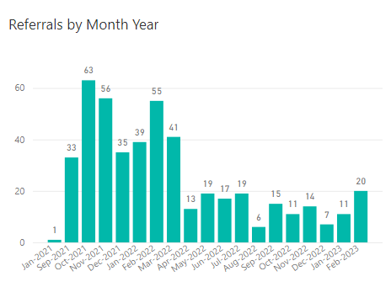
Referrals Family
606

Slide 4
Referrals Individual
964

Slide 5
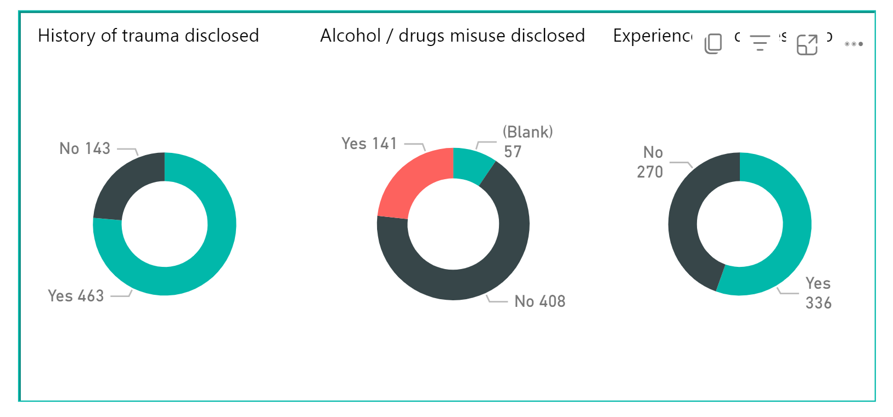
Outcome Graphs

Slide 6
Outcome Graphs

Slide 7
Outcome Graphs

Slide 8
Outcome Graphs

Slide 9
Case Study Videos
https://youtu.be/Fg2FjIhxh68

Slide 10
Whole Family Therapeutic Intervention

