Slide 1
#ACEAwareCity #KnowYourStory
Liverpool: a city that builds protection from, and resilience for, Adverse Childhood Experiences

Slide 2
How do we get there?
2019: ACEs strategic statement published and a delivery group formed.
ACEs project:
Prevent ACEs from happening
Support young people affected by ACEs
Support adults affected by their own ACEs

Slide 3
Everyone has a story….. What happens to us, changes us

Slide 4
1. Prevent ACEs from happening “It’s only when we know can we understand. Only when we understand can we recover” James Docherty, #ACESasassets
Develop and co-produce a city wide policy and framework that:
defines ACEs for Liverpool - adding to original study with current context
lays out a commitment to raising awareness and working in trauma responsive ways cross sector.
develops a shared language
includes response pathways that highlight multiple points of intervention and is widely used cross sector
delivers workforce training and a public facing campaign

Slide 5
How you can contribute:
Attend a focus group
Google: ACEs focus group SIL to sign up
Complete the workforce survey

Slide 6
The story of hope

Slide 7
Everyone has a story….. What happens to us, changes us - Know your story - Own your story - Tell your story - Write your next chapter

Slide 8
2. Support young people affected by ACEs
Coming Together Launch Event
hosted and facilitated by community champions and the workforce in venues across the city
includes the organisations that are already in place to build relationships and connections
showcases some arts and sports activity, and hopefully, some performances from NOW festival

Slide 9
How you can contribute:
Host a launch event at your venue / community centre / school / clinic
Participate in a launch event by showcasing your organisation
Recommend any community champions you may know

Slide 10
3.To support with the potential impacts of their own ACEs across their life course
ACEs training course for adults
Co designed and produced
Accredited (hopefully)
Four session model
Delivered via train the trainer

Slide 11
How you can contribute:
Participate in the working group to design the course – if ACEs is your area of expertise, you have experience working with adults and facilitating programmes and would like to be part of it, please get in touch!
Become a trainer to deliver the program within your organisation
Talk about the course with the people you work with, share resources and information (when available)

Slide 12
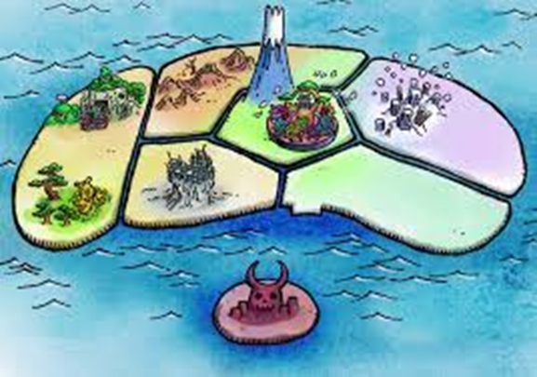
The challenge

Slide 13
The ending By the end of the project, Liverpool will:
Have a policy and framework that defines and supports the response to ACEs cross sector
Have a workforce confident to identify and discuss ACEs
Have a workforce that is utilising a cohesive, multi faceted response pathway to ACEs that increases agency
Have a workforce that understands the impact of their own ACEs on their practice
Have a population that is aware of ACEs and activated to build resilience and access support
Have a cohort of trained professionals to educate the population about ACEs from a strength based model
Have a body of resources for professionals to utilise to prevent and support ACEs
Have a cohort of ACE aware and resilient adults who can support themselves and each other to prevent ACEs and end the intergenerational cycle in their own families

Slide 14
Thank You
If you have any questions, comments, or would like to contribute in any way, please get in touch:
Judith Bairstow
Judith.Bairstow@si.liverpool.gov.uk
07540 642386

