Slide 1
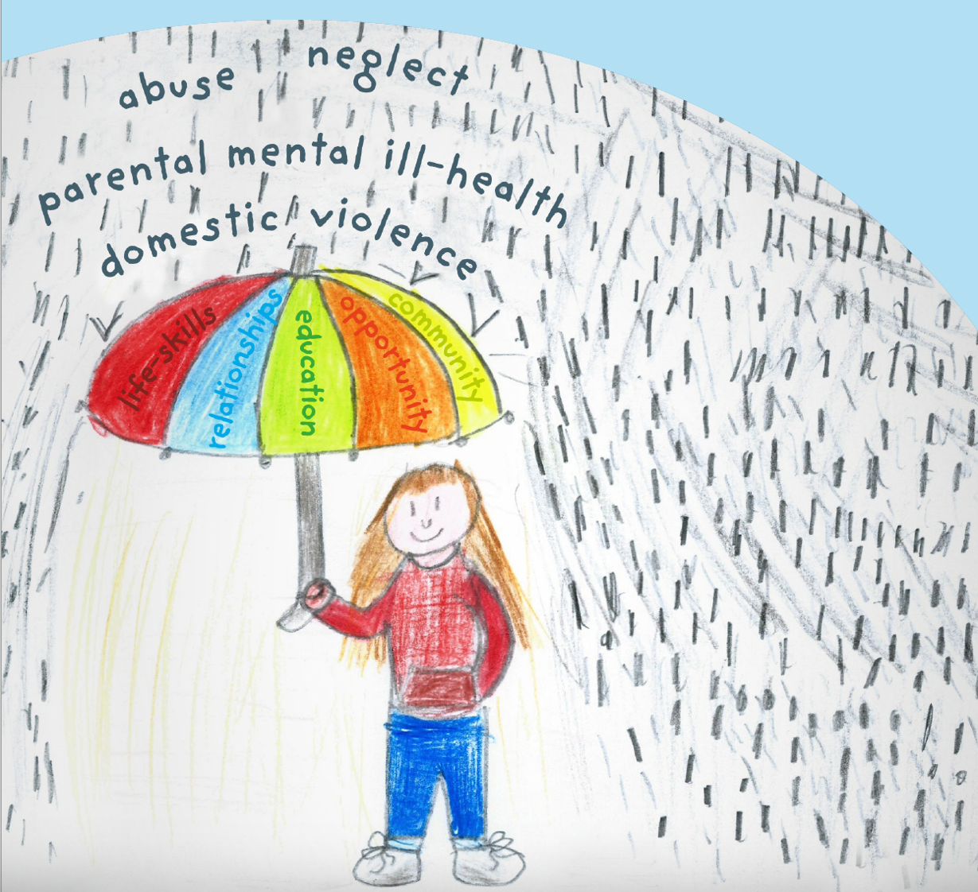
Adverse Childhood Experiences
Evidenced based approaches for preventing and responding to avoidable childhood adversity
Zara Quigg
Prof Behavioural Epidemiology
Public Health Institute, Liverpool John Moores University
E. z.a.quigg@ljmu.ac.uk T. @zaraquigg
With thanks to Prof Mark A Bellis for slide and content production
State of the Art and Options for Action

Slide 2
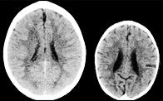
Adverse Childhood Experiences ACEs - The Life Course
Early Death
Non-Communicable Disease, Disability, Social Problems, Low Productivity
Adopt Health Harming Behaviours and Crime
Social, Emotional and Learning Problems
Disrupted Nervous, Hormonal
and Immune Development
ACEs Adverse
Childhood Experiences
Pre-birth Stressors
Developed from Felitti et al. 1998, Baumeister et al., Mol Psychiatry. 2016 May; 21(5): 642–649.; Perry, Society For Neuroscience: Proceedings from Annual Meeting, New Orleans, 1997, Puteman et al., vol. 113 no. 42, E6335–E6342, doi: 10.1073/pnas.1525602113
Bellis 2016

Slide 3
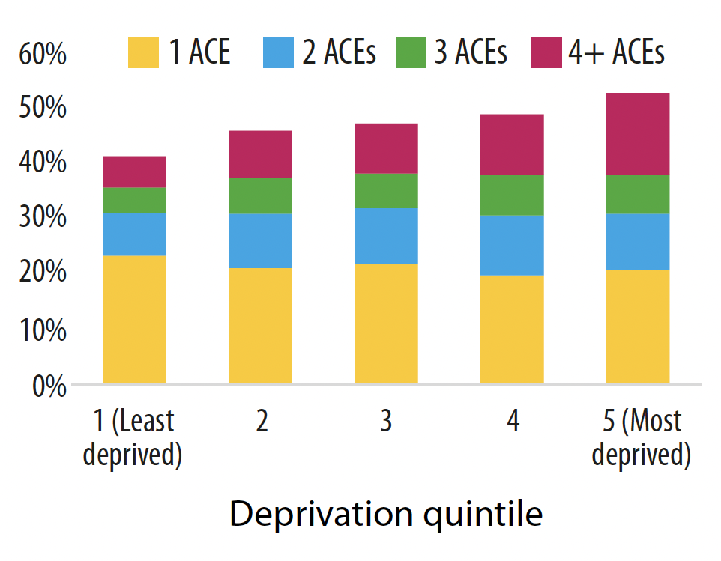
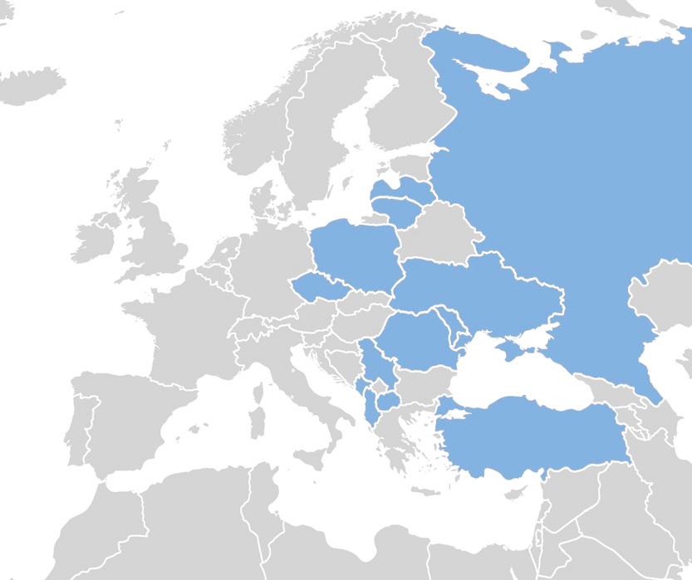
How many people have suffered ACEs? – General Population Surveys
Prevalence of ACEs in adults in England and Wales by residential deprivation
ACEs measured
Physical abuse
Sexual abuse
Emotional abuse
Parental separation
Domestic violence
Household member:
Mental illness
Alcohol problem
Drug user
Incarcerated
Euro
18%
6%
10%
16%
13%
11%
16%
3%
5%
England
15%
6%
18%
24%
12%
12%
10%
4%
4%
Wales
16%
7%
17%
25%
17%
18%
13%
6%
4%
USA
18%
12%
34%
28%
18%
17%
28%
8%
Physical abuse
18%
average
Eastern Europe 49% suffered at least one ACE, 6% 4+ ACEs
England 48% suffered at least one ACE, 9% 4+ ACEs
Wales 50% suffered at least one ACE, 14% 4+ ACEs
USA 62% suffered at least one ACE, 16% 4+ ACEs
Russian Federation
13%
16%
Latvia
Lithuania
Poland
13%
15%
Ukraine
19%
Czech Republic
11%
18%
Moldova
Romania
23%
18%
Serbia
Montenegro
20%
7%
North Macedonia
41%
Albania
15%
Turkey
Bull World Health Organ 2014;92:641–655B; Bellis et al, 2014, 2016, 2018; Merrick et al, 2018

Slide 4
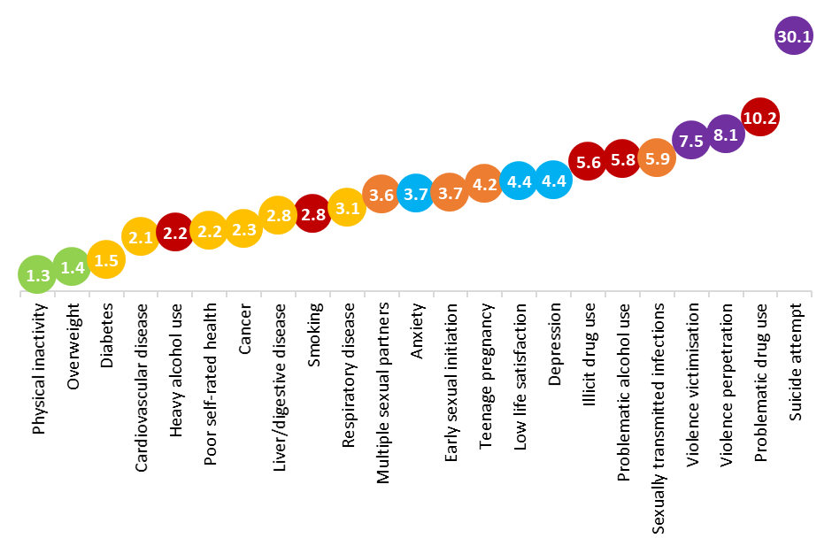
Increased risks of health outcomes in adults with multiple ACEs (compared with 0 ACEs)
Mental health
Substance use
Sexual health
Physical health
Violence
Weight and exercise
Lancet Public Health 2019 Oct;4(10):e517-e528. doi: 10.1016/S2468-2667(19)30145-8. Epub 2019 Sep 3.

Slide 5
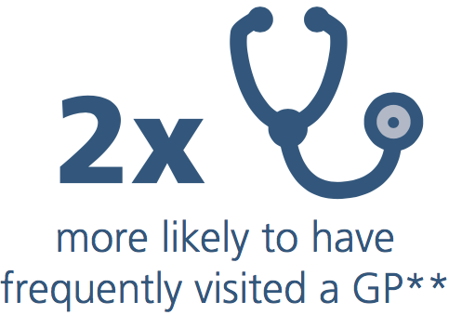
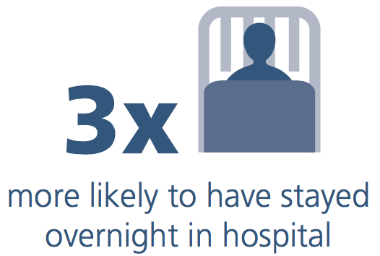
Wales: Length of Healthy Life
Individuals Diagnosed with a Major Disease by Age (%)
Hit Someone in Last 12 months ♂
Odds - poor health and school attendance to age 18 years
(Corrected for deprivation)
40%
0 ACEs
4+ ACEs
0 ACEs
Differences remain after adjusting for Deprivation
1 ACE
2-3 ACEs
41%
Major Diseases
Cancer
Stroke
Type 2 Diabetes
Cardio Vascular Disease
Digestive/Liver Disease
Respiratory Disease
4+ ACEs
6%
10+ years
21%
(E&W; n>15000)
Age Group
Adverse Childhood Experiences and their association with chronic disease and health service use in the Welsh adult population; 2016

Slide 6
Just One Adverse Childhood Experience?
Physical Abuse
Verbal Abuse
Sexual Abuse
Parental Separation
Domestic Violence
Mental Ill-health
Alcohol Problems
Violence perpetration
(% last 12 months)
Teenage pregnancy (% ever)
Low Mental Wellbeing
(% current)
Obesity (% current)
Bellis MA, et al. BMJ Open 2023;13:e072916. doi:10.1136/bmjopen-2023-072916

Slide 7
The Costs of ACEs across Europe
DALYs – Approximately 25 million in Europe and 13 million in North America
(after double-counting removed)
$Billions
Per year
$
46
$
143
$
23
$
29
Fraction attributable to ACEs
$
165
$
47
$
40
$
117
$
185
$
16
European costs per year $581 billion; 77% multiple & 23% single ACES
Bellis et al 2019

Slide 8
Tackling Adverse Childhood Experiences
Socio-economic and other Macro drivers
Prevention
Trauma informed
Services
Resilience

Slide 9
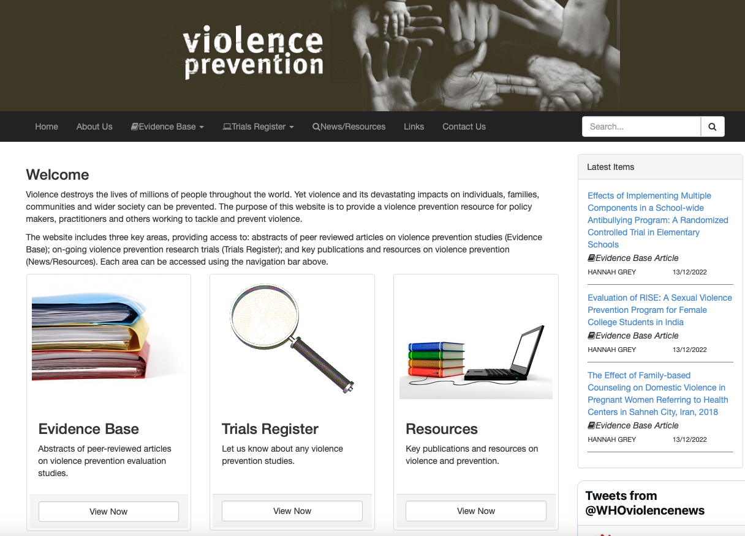
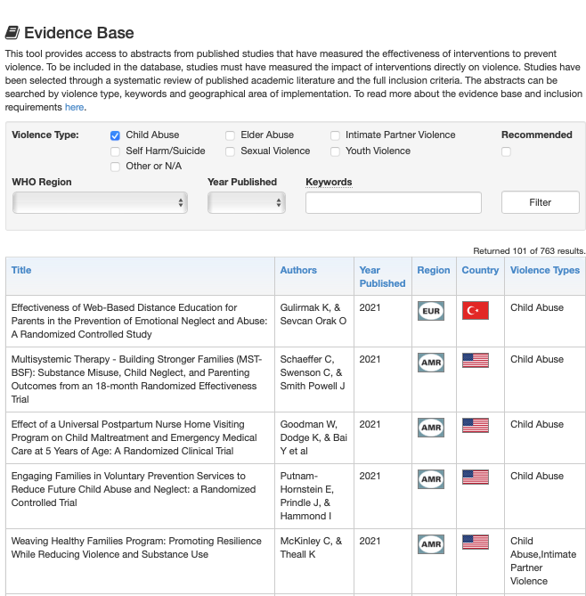
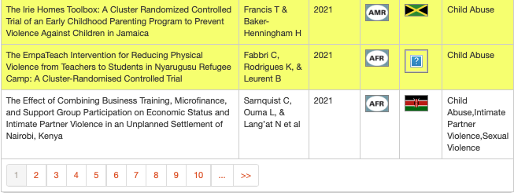
763
www.preventviolence.info

Slide 10
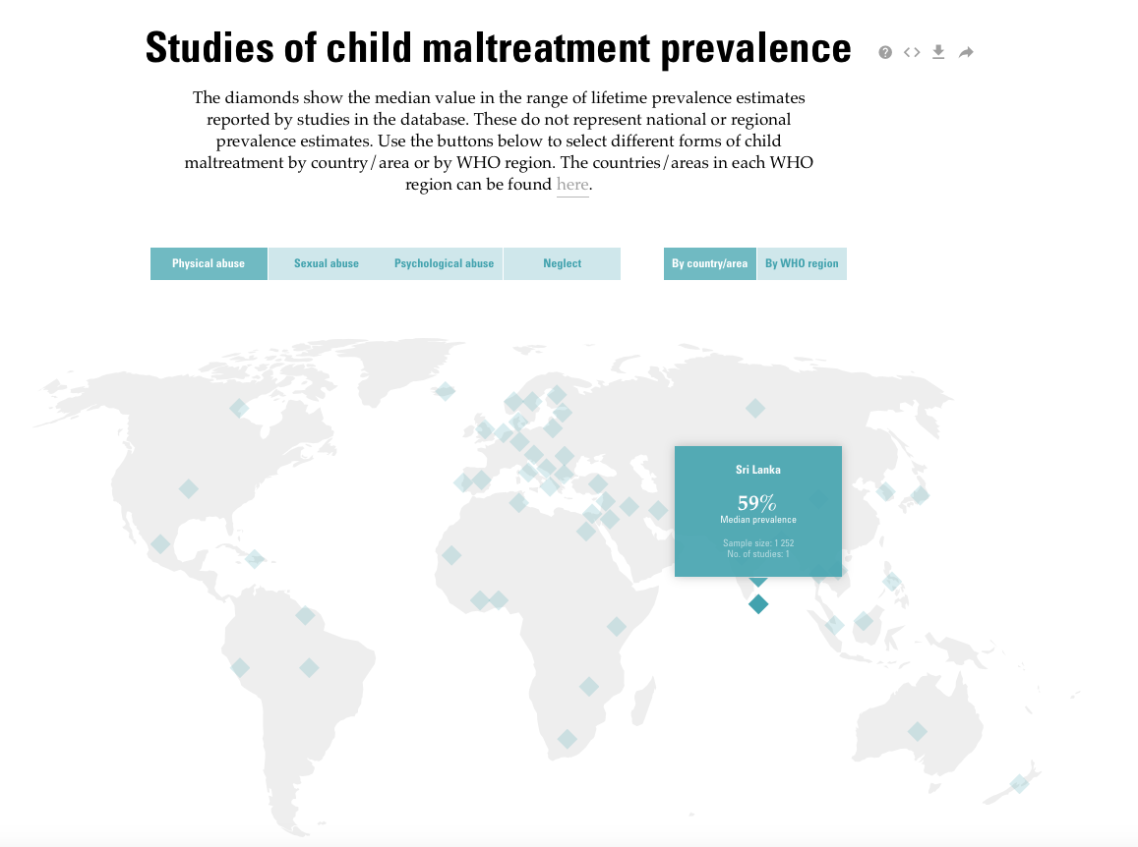
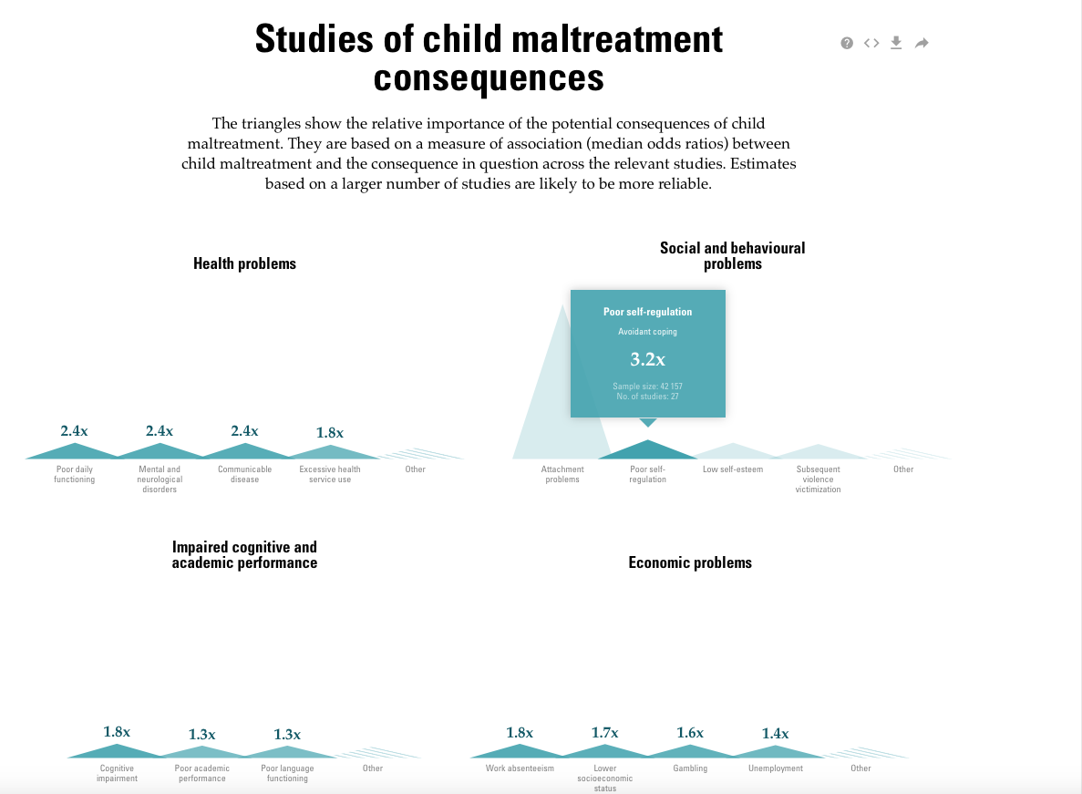
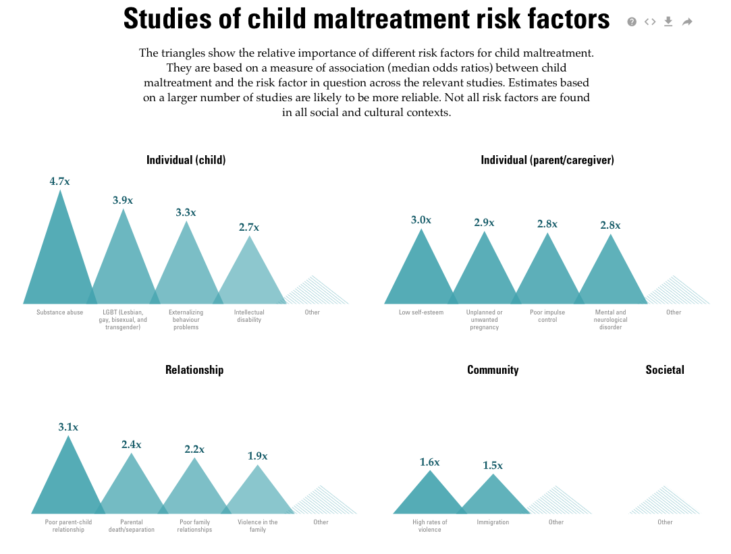
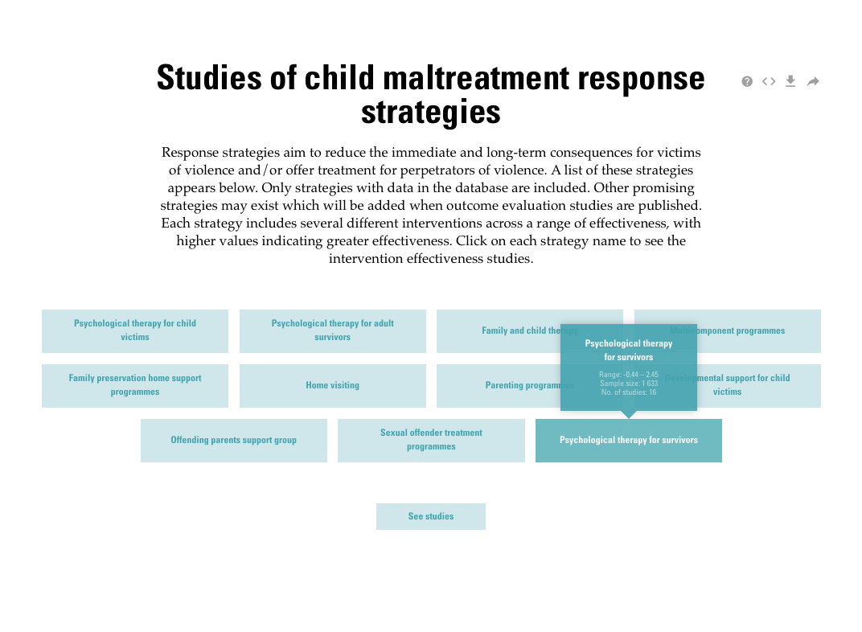
https://apps.who.int/violence-info/
Live

Slide 11
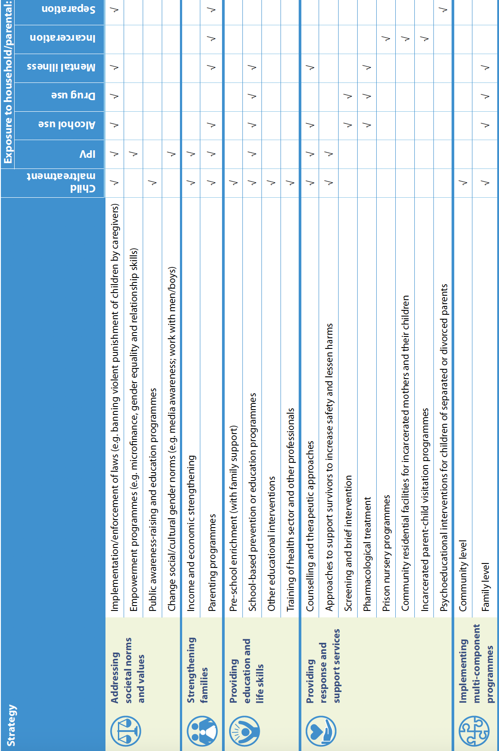
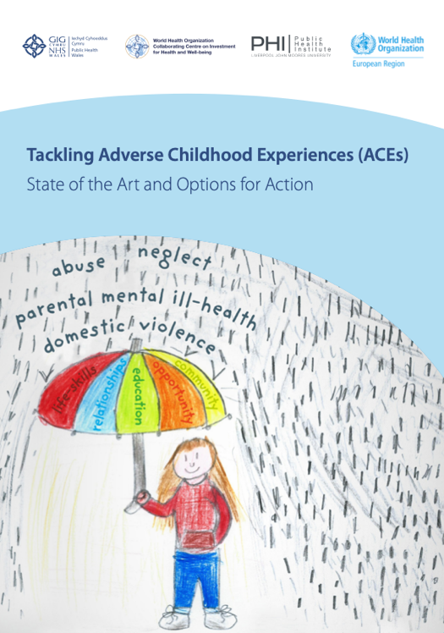
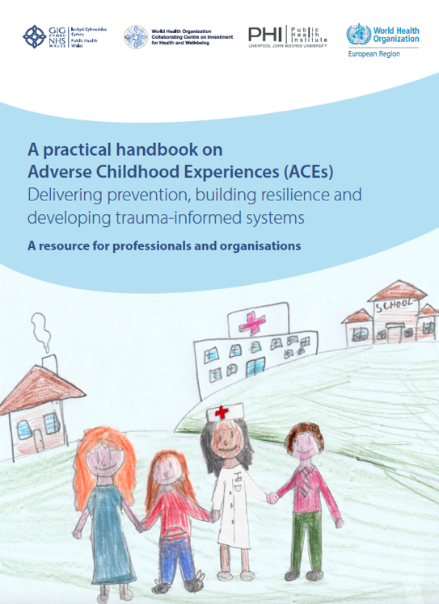
Effective/promising interventions to prevent and/or mitigate the impacts of ACEs, or prevent risk factors for ACEs
Strategy
Draft

Slide 12
Some Family Based and Multi-component programmes to tackle ACEs

Slide 13
California’s state-wide effort to reduce ACEs
and toxic stress by half in one generation
Originally by California Surgeon General Dr Nadine Burke-Harris, → Uni of California
Working across health, human services, education and non-profit sectors
Screening for ACEs
ACE Awareness campaign
Summer 2023, online professional learning module to help early care and education personnel respond to trauma and stress in children
Ç√
Jan 2020 to March 2022 1.34 million screenings
Dec 2019 to Nov 2022 28,000 completed ACE Awareness training including 12,400 clinicians
Creating awareness of lasting impacts of ACEs
Practical tools for healing, prevention
Encouraging people to:
Measure their ACE score
Understand impact on their life
Training, resources and finances to primary care providers to screen for ACEs and apply trauma-informed care
$29 payment for each screening

Slide 14
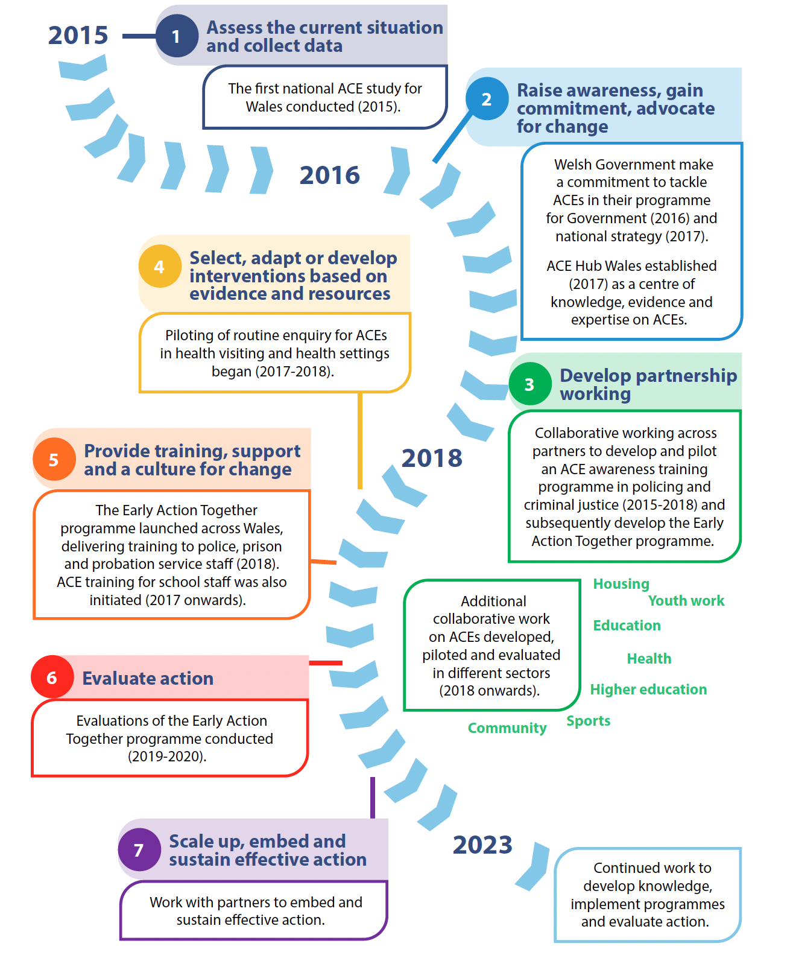
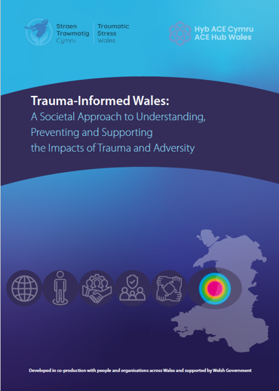
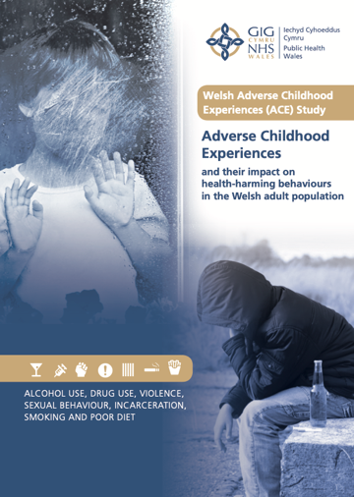
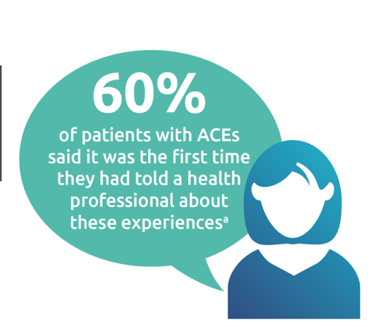
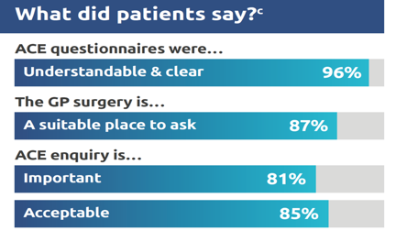
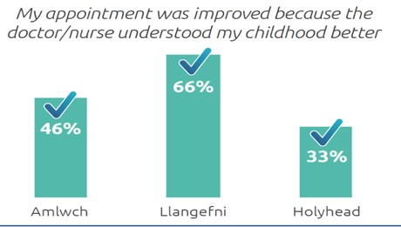
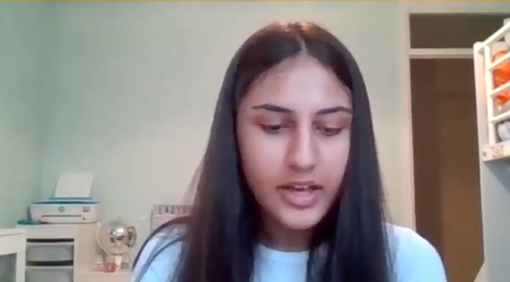
2023
Develop partnership working
Policing and criminal justice
Schools
Prison
Probation
Evaluation
Provide training, support and a culture for change
Programme launched across Wales, delivering training
Screening Pilots
Routine enquiry
Health visiting
Primary Care
Scale up, embed and sustain effective
Assess - First national ACE study for Wales
2015

Slide 15
Policy - Developing a National Trauma Practice Framework for Wales
Everyone has a role in sensitively facilitating opportunities and life chances for people affected by trauma and adversity
People, families, communities, organisations, systems take account of the widespread impact of adversity and trauma and understand ways of preventing and healing
People recognise the multiple presentations of being affected by trauma in individuals, families, communities, staff, and others
Knowledge about trauma and its effects are integrated into policies, procedures, and practices including actively resisting traumatising people again and committing to ‘do no harm’
Trauma Aware
Trauma Skilled
Trauma Enhanced
Specialist Interventions
Specialist
Universal
Everyone – Understand people’s lives affected by trauma, strengthen coping, build empathy
Staff & Volunteers who have direct contact with those who may be affected – Compassionate and caring support
Workers and Carers with regular and intensive interactions – Well established practice and policy
Specialised Practitioners low and high intensity interventions – Psychological therapies, policy influence, specialist approaches
Notes:
Jp Hopkins

Slide 16
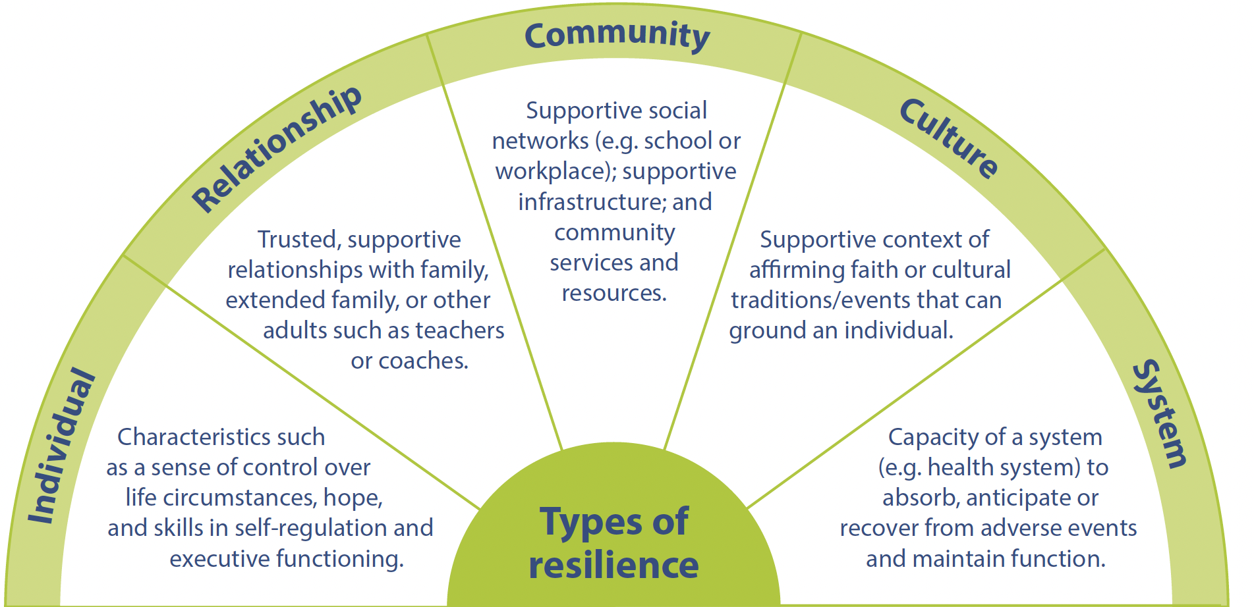
Resilience
School Absenteeism (>20 days/year)
ACEs and Resilience
Bellis et al, BMC Public Health, 2018
Resilience
Low
High

Slide 17
Summary
May not be entirely new components, but new joined up perspective
Multiple services and Government Departments can engage on same agenda
Reasons to examine components but wary of splitting field
Many questions remain unanswered but enough evidence for action
Emerging challenges with strong ACE perspective: Asylum and Refugees, Conflict zone, COVID-19
Cycles of social determinants and ACEs - multiple points for intervention – critical element is taking every opportunity

